Slide 1
DEVICE TREE
The language to describe hardware

Slide 2
AGENDA
Introduction
Booting flow with the Device Tree support
Basic Device Tree syntax
Examples with Device Tree
General functions in device tree API

Slide 3
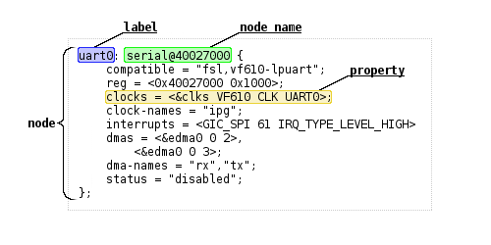
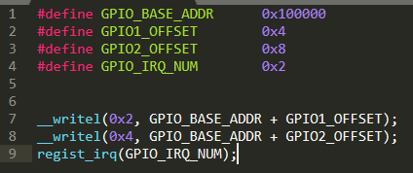

INTRODUCTION
Old style of kernel code
New style with device tree
Disadvantage
Hard to reuse source code

Slide 4
DEVICE TREE ADVANTAGE
Simple to change the configuration
Easily add support for new hardware
Can reuse and over ride existing .dots files
Easy to read and understand descriptions of hardware

Slide 5
BOOTING FLOW
Boot loader load kernel image and dtb file
Initialize hardware data base
Call probe function of all drives

Slide 6
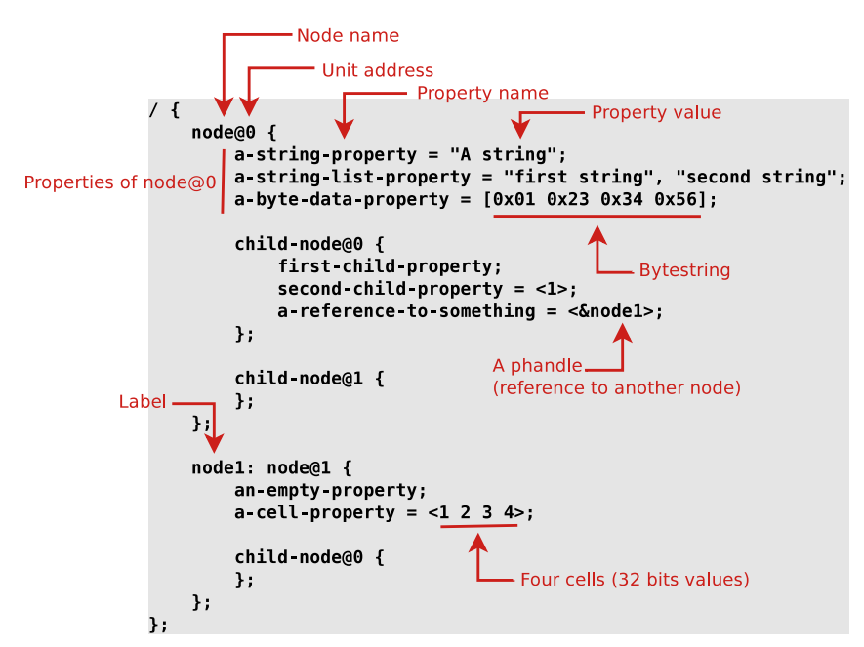
Basic Device Tree syntax
Node name
Unit address
Property name
Property value
Value encode
Reference with other node
Node tuân theo cú pháp chuẩn.
Node tự định nghĩa.

Slide 7
Device tree compilation
Include other device tree
Reuse and override
Device tree located in source code
Tool to compile
Device Tree Blob
.dtsi files are included files, while .dts files are final
arch/platform/boot/dts
scripts/dtc
.dts + .dtsi = .dtb

Slide 8
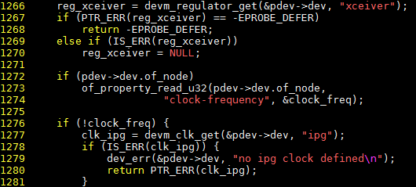
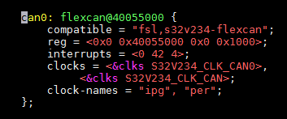
Examples with Device Tree
Device tree node
Driver code

Slide 9
General function in device tree API
All functions are located at include/Linux/of.h
Getting a reference to the clock
clk_get(&pdev->dev, NULL)
Getting the I/O registers resource
platform_get_resource(pdev, IORESOURCE_MEM, 0)
Check some custom property
struct device_node *np = pdev->dev.of_node
of_get_property(np, "fsl,uart-has-rtscts", NULL)

Slide 10
SUMMARY
Booting flow with device tree supported.
How to a device tree blob is compiled.
Device tree basic syntax
Reuse and over ride in device tree
Device tree API function

Slide 11
Practice
Add 1 node để định nghĩa phần cứng cho đèn led và button.
Địa chỉ bắt đầu của các thanh ghi cho đèn led và button.
Số hiệu ngắt cho button.
Viết lại driver để điều khiển led và button dựa vào device tree.
Ấn button thì đèn led sáng.
Nhả button thì đèn led tắt.

Slide 12
Reference
Device tree advantage
Device tree for dummy

Slide 13

Thank you

